Slide 1
Demystifying Data Analytics
Notes:
This template can be used as a starter file for presenting training materials in a group setting.
Sections
Right-click on a slide to add sections. Sections can help to organize your slides or facilitate collaboration between multiple authors.
Notes
Use the Notes section for delivery notes or to provide additional details for the audience. View these notes in Presentation View during your presentation.
Keep in mind the font size (important for accessibility, visibility, videotaping, and online production)
Coordinated colors
Pay particular attention to the graphs, charts, and text boxes.
Consider that attendees will print in black and white or grayscale. Run a test print to make sure your colors work when printed in pure black and white and grayscale.
Graphics, tables, and graphs
Keep it simple: If possible, use consistent, non-distracting styles and colors.
Label all graphs and tables.

Slide 2
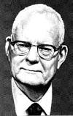
In God we trust. All others must bring data.
—William Edwards Deming (a business professor famous for work in manufacturing)

Slide 3

People . . . operate with beliefs and biases.
To the extent you can eliminate both and replace them with data, you gain a clear advantage.
—Michael Lewis, Moneyball: The Art of Winning an Unfair Game
(American financial journalist and non fiction author)

Slide 4
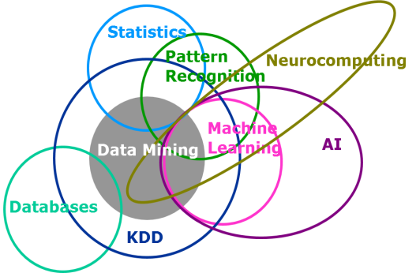
Data Mining
Data mining is the application of the methods of statistics, data analysis, and machine learning to the exploration and analysis of large data sets, with the aim of extracting new and useful information that will benefit the owner of these data.

Slide 5
Hierarchy
Statistics is just about the numbers, and quantifying the data. There are many tools for finding relevant properties of the data but this is pretty close to pure mathematics.
Data Mining is about using Statistics as well as other programming methods to find patterns hidden in the data so that you can explain some phenomenon. Data Mining builds intuition about what is really happening in some data and is still little more towards math than programming, but uses both.
Machine Learning uses Data Mining techniques and other learning algorithms to build models of what is happening behind some data so that it can predict future outcomes. Math is the basis for many of the algorithms, but this is more towards programming.
Artificial Intelligence uses models built by Machine Learning and other ways to reason about the world and give rise to intelligent behavior whether this is playing a game or driving a robot/car..
In short
Statistics quantifies numbers
Data Mining explains patterns
Machine Learning predicts with models
Artificial Intelligence behaves and reasons

Slide 6
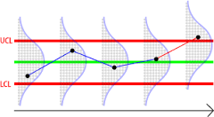
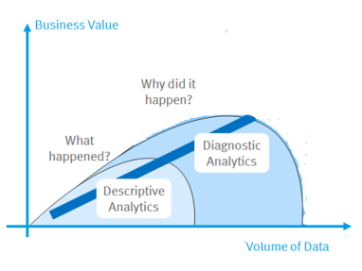
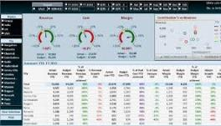
Descriptive Statistics
When Data under Analysis is Known the process is called Descriptive Statistics.
MIS Reporting : It is all about what has happened in the past or currently happening. dashboards, charts, graphs, etc. Analytics is finding out the reasons of what these trends are occurring - some slice & dice, data mining
Statistical process control, Inventory status reports, Financial statements, Performance reports etc. For HR it is about the attrition rate, headcounts etc..
These reports are essential for analyzing different aspects of business. These reports also help to answer 'what-if' questions like what would be the effect on cash flows of a company if the credit term is changed for its customers etc

Slide 7
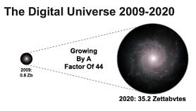
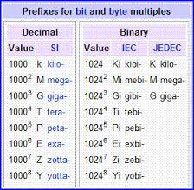
Exploding data volume
Every medical procedure, credit application, Facebook post, movie recommendation, fraudulent act, spammy e-mail, and purchase of any kind—each positive or negative outcome, each successful or failed sales call, each incident, event, and transaction—is encoded as data and warehoused.
But data isn’t the gold. Data in its raw form is boring crud.
The gold is what’s discovered therein

Slide 8
Big Data Characterization –V3
Big Data Analytics : One of the most “hyped” terms in the market today, there is no consensus as to how to define big data.
Big data does not refer to data volume alone. What it means is that you are not only getting a lot of data. It is also coming at you fast, it is coming at you in complex format, and it is coming at you from a variety of sources.
Big data is high-volume, high-velocity and/or high-variety information assets that demand cost-effective, innovative forms of information processing that enable enhanced insight, decision making, and process automation.---Gartner

Slide 9
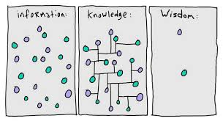
Huge Data !!
Can we from Data ?
LEARN
Hidden Information ?
Can We ?
PREDICT

Slide 10

Predictive Analytics
The future is unknown, and uncertainty is the only thing about which we’re certain.
Predicting better than pure guesswork, even if not accurately, delivers real value.

Slide 11
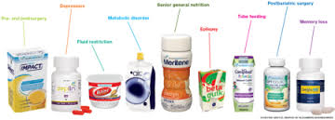





Number of prospective Customers : 1 Million
Cost of Campaign : $2 per prospect
Your Product Price : $ 220
Experience : 1 % respond to the campaign
1 % buy product
Million Prospects
10,000 responses
$220 for each positive response
Overall profit = Revenue – Cost
=($220 * 10,000 responses) - ($2 * 1million)
= $2,200,000 – 2,000,000
= $ 200,000

Slide 12
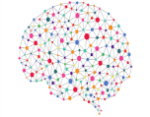

Quarter of Million Prospects
3 % buy product
Predictive Analytics
3 % buy product
250,000 Prospects
7,500 responses
$220 for each positive response
Overall profit = Revenue – Cost
=($220 * 7500 responses) - ($2 * 250,000)
= $1,650,000 – 500,000
= $ 1,150,000

Slide 13
What is the difference between
&
Predictive Analytics
Machine Learning

Slide 14
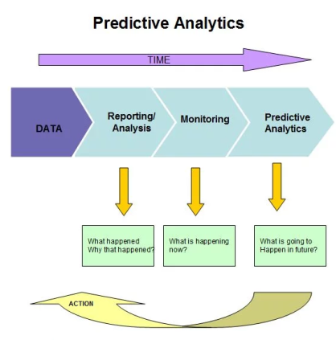
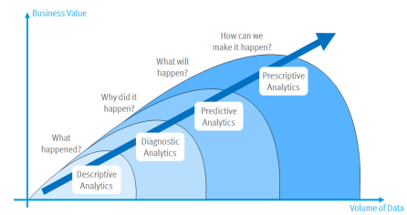
Predictive Analytics
Predictive analytics (PA)—Technology that learns from experience (data) to predict the future behavior of individuals in order to drive better decisions

Slide 15
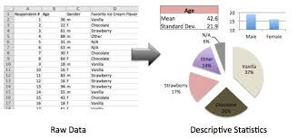
Demographic Answers
How Long Mr. X been a customer ?
What is Mr. X annual Salary ?
What is Mr. X Weekly Spend
Where does Mr. X live ? What is the value of her home ?
How many family members does Mr. X have ?
Performance Answers
What product Mr. X buy last week ?
How much did Mr. X spend last month ?
To what promotions did Mr. X respond ?
Is Mr. X spending more /less versus last month
Descriptive Statistics

Slide 16
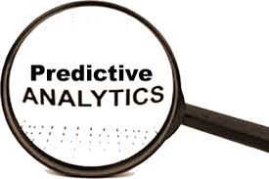
Predictive Answers
How many times does Mr. John is like to visit store during Christmas?
What promotion is Mr. John likely to use ?
What is the likelihood that Mr. John will buy product.
What is the like hood that Mr. John will buy product Z when he buys product Y
What is the profit potential of Mr. John over 2 years
Recommendation
What is the best price to get Mr. John to buy private label cookie.
What new product introductions should we recommend to Mr. John
What are the best promotions and on what product, to get Mr. John to visti the store 2 more time in a month ?

Slide 17
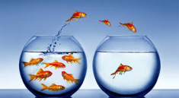
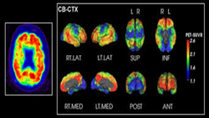



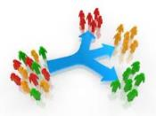

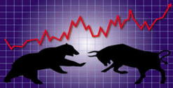
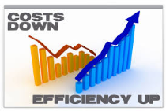
Applications
Churn Prediction
Medical Image Analytics
Credit Card Fraud
Sentiment Analysis
Human Resources
Credit Scoring
Share Market

Slide 18
So What Is Machine Learning?
Tom Mitchell’s Machine Learning Definition
A computer program is said to learn from experience E with respect to some class of tasks T and performance measure P, if its performance at tasks in T, as measured by P, improves with experience E.
Automating automation
Getting computers to program themselves
Writing software is the bottleneck
Let the data do the work instead!

Slide 19
Why “Learn”?
Machine learning is programming computers to optimize a performance criterion using example data or past experience.
There is no need to “learn” to calculate payroll
Learning is used when:
Human expertise does not exist (navigating on Mars),
Humans are unable to explain their expertise (speech recognition)
Solution changes in time (routing on a computer network)
Solution needs to be adapted to particular cases (user biometrics)

Slide 20
Machine Learning…….
Traditional Programming
Data
Computer
Output
Program
Machine Learning
Data
Computer
Program
Output

Slide 21
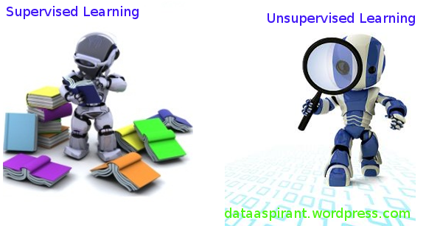
Supervised /Unsupervised Learning

Slide 22
Algorithms
Supervised learning
Prediction
Classification (discrete labels), Regression (real values)
Unsupervised learning
Clustering
Probability distribution estimation
Finding association (in features)
Dimension reduction
Semi-supervised learning
Reinforcement learning
Decision making (robot, chess machine)

Slide 23
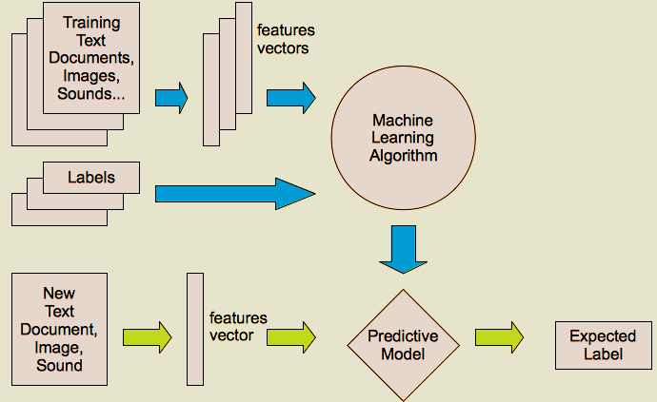
Supervised learning

Slide 24
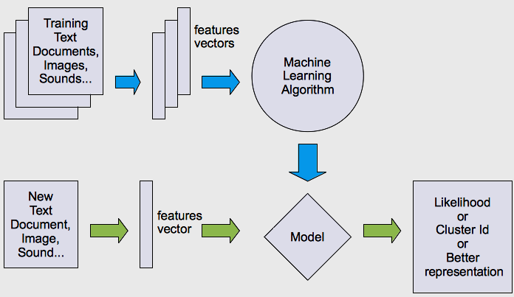
Unsupervised learning

Slide 25
Supervised Learning techniques
Supervised learning problems can be further grouped into regression and classification problems.
Classification: A classification problem is when the output variable is a category, such as “red” or “blue” or “disease” and “no disease”.
Regression: A regression problem is when the output variable is a real value, such as “dollars” or “weight”.

Slide 26
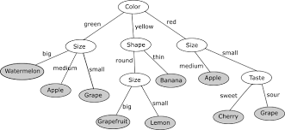
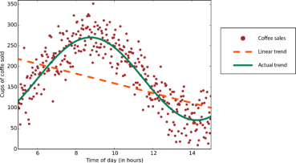
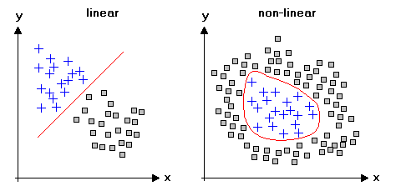
Supervised Learning

Slide 27
Unsupervised learning
Unsupervised learning problems can be further grouped into clustering and association problems.
Clustering: A clustering problem is where you want to discover the inherent groupings in the data, such as grouping customers by purchasing behavior.
Association: An association rule learning problem is where you want to discover rules that describe large portions of your data, such as people that buy X also tend to buy Y.
Some popular examples of unsupervised learning algorithms are:
k-means for clustering problems.
Apriori algorithm for association rule learning problems.

Slide 28
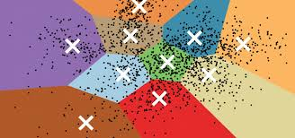
Unsupervised Learning

Slide 29
Learning techniques
Unsupervised learning categories and techniques
Clustering
K-means clustering
Spectral clustering
Self Organizing Map
…
Density Estimation
Gaussian mixture model (GMM)
Graphical models
…
Dimensionality reduction
Principal component analysis (PCA)
Factor analysis
…

Slide 30
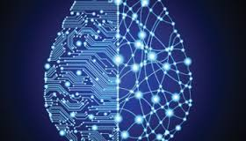
Artificial Neural Network

Slide 31
Artificial Neural Network -Definition
A Artificial neural network is a massive parallel distributed processor made up of simple processing units, which has a natural propensity for storing experimental knowledge and making it available for use. It resembles the brain in two respects:
Knowledge is acquired by the network from its environment through a learning process.
Inter-neuron connection strengths, known as synaptic weights, are used to store the acquired knowledge.

Slide 32
Biological Motivation
Human brain is a densely interconnected network of approximately 10¹¹ neurons, each connected to, on average, 10⁴ others.
Neuron activity is excited or inhibited through connections to other neurons.
The fastest neuron switching times are known to be on the order of 10⁻³ sec.

Slide 33
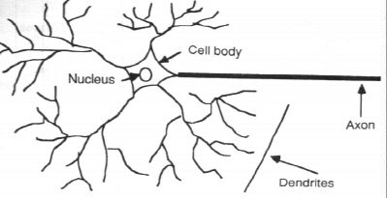
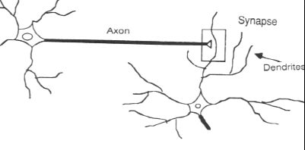
The cell itself includes a nucleus (at the center).
To the right of cell 2, the dendrites provide input signals to the cell.
To the right of cell 1, the axon sends output signals to cell 2 via the axon terminals. These axon terminals merge with the dendrites of cell 2.
Axons = the transmission lines
Dendrites = the receptive zones
Action potentials, spikes
originate at the cell body of neurons and then propagate across the individual neurons at constant velocity and amplitude

Slide 34
Portion of a network: two interconnected cells.
Signals can be transmitted unchanged or they can be altered by synapses. A synapse is able to increase or decrease the strength of the connection from the neuron to neuron and cause excitation or inhibition of a subsequence neuron. This is where information is stored.
The information processing abilities of biological neural systems must follow from highly parallel processes operating on representations that are distributed over many neurons. One motivation for ANN is to capture this kind of highly parallel computation based on distributed representations.

Slide 35
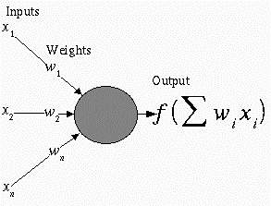
Neural Network Representation
An ANN is composed of processing elements called or perceptrons, organized in different ways to form the network’s structure.
Processing Elements
An ANN consists of perceptrons. Each of the perceptrons receives inputs, processes inputs and delivers a single output.
The input can be raw input data or the output of other perceptrons.
The output can be the final result (e.g. 1 means yes, 0 means no) or it can be inputs to other perceptrons.

Slide 36
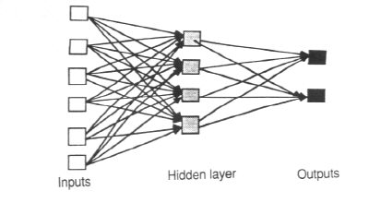
The network
Each ANN is composed of a collection of perceptrons grouped in layers. A typical structure is shown in Fig
Note the three layers: input, intermediate (called the hidden layer) and output.
Several hidden layers can be placed between the input and output layers.

Slide 37
The Neuron
The neuron is the basic information processing unit of a NN. It consists of:
A set of synapses or connecting links, each link characterized by a weight:
W₁, W₂, …, W_{m}
An adder function (linear combiner) which computes the weighted sum of the inputs:
Activation function (squashing function) for limiting the amplitude of the output of the neuron.

Slide 38
The Neuron
Bias
b
x₁
w₁
Activation
function
Local
Field
v
Output
y
Input
signal
x₂
w₂
Summing
function
x_{m}
w_{m}
Synaptic
weights

Slide 39
Common Activation Functions
Step function:
g(x)=1, if x >= t ( t is a threshold)
g(x) = 0, if x < t
Sign function:
g(x)=1, if x >= t ( t is a threshold)
g(x) = -1, if x < t
Sigmoid function: g(x)= 1/(1+exp(-x))

Slide 40
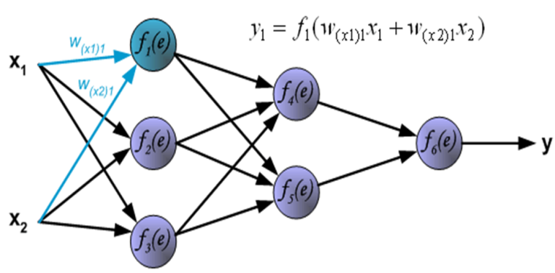
Typical Neural Network Architecture

Slide 41
Machine Learning in Manufacturing
In manufacturing, it can support functions such as:
Automation: machine learning systems are not always given an embodied form, but they can be used in robotics, creating systems that can undertake complex tasks as part of production lines.
Optimisation: the analysis provided by machine learning systems can be used to optimise processes, products or prices, and increase productivity as a result.
Predictive maintenance: the patterns detected by machine learning systems can be used to predict which bits of equipment or installations are going to fail, before this failure occurs, so that maintenance efforts can be directed accordingly.
Personalisation: machine learning algorithms can analyse data about customers and their preferences, and use this to create personalised products.

Slide 42
Applications in Other Areas
Face detection
Object detection and recognition
Image segmentation
Multimedia event detection
Economical and commercial usage

Slide 43


Slide 46
Applications in Healthcare and Life science
Alerts and diagnostic from real-time patient data
Disease identification and risk stratification
Patient triage optimization
Proactive health management
Healthcare provider sentiment analysis
Medical imaging (Heart, Lung, Breast, Kidney)

Slide 47
Algorithms
The success of machine learning system also depends on the algorithms.
The algorithms control the search to find and build the knowledge structures.
The learning algorithms should extract useful information from training examples.

Slide 48
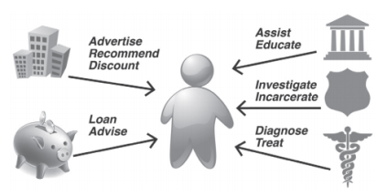
Predictive Analytics and Forecasting
Predictions drive how organizations treat and serve an individual, across the operations that define a functional society.
Predictive Analytics is a completely different animal from forecasting. Forecasting makes aggregate predictions on a macroscopic level. How will the economy fare? Which presidential candidate will win more votes in Ohio? Whereas forecasting estimates the total number of ice cream cones to be purchased next month in Nebraska, predictive technology tells you which individual Nebraskans are most likely to be seen with cone in hand.

Slide 49
To become a Data Scientist:
Education: 88% have a Master’s Degree and 46% have PhDs
In-depth knowledge of SAS and/or R: For Data Science, R is generally preferred.
Python coding: Python is the most common coding language that is used in data science along with Java, Perl, C/C++.
Hadoop platform: Although not always a requirement, knowing the Hadoop platform is still preferred for the field. Having a bit of experience in Hive or Pig is also a huge selling point.
SQL database/coding: Though NoSQL and Hadoop have become a major part of the Data Science background, it is still preferred if you can write and execute complex queries in SQL.
Working with unstructured data: It is most important that a Data Scientist is able to work with unstructured data be it on social media, video feeds, or audio.

Slide 50
To become a Big Data professional:
Analytical skills: The ability to be able to make sense of the piles of data that you get. With analytical abilities, you will be able to determine which data is relevant to your solution, more like problem solving.
Creativity: You need to have the ability to create new methods to gather, interpret, and analyze a data strategy. This is an extremely suitable skill to possess.
Mathematics and statistical skills: Good, old fashioned “number crunching”. This is extremely necessary, be it in data science, data analytics, or big data.
Computer science: Computers are the workhorses behind every data strategy. Programmers will have a constant need to come up with algorithms to process data into insights.
Business skills: Big Data professionals will need to have an understanding of the business objectives that are in place, as well as the underlying processes that drive the growth of the business as well as its profit

Slide 51
To become a Data Analyst:
Programming skills: Knowing programming languages are R and Python are extremely important for any data analyst.
Statistical skills and mathematics: Descriptive and inferential statistics and experimental designs are a must for data scientists.
Machine learning skills
Data wrangling skills: The ability to map raw data and convert it into another format that allows for a more convenient consumption of the data.
Communication and Data Visualization skills
Data Intuition: it is extremely important for professional to be able to think like a data analyst.

